Slide 1

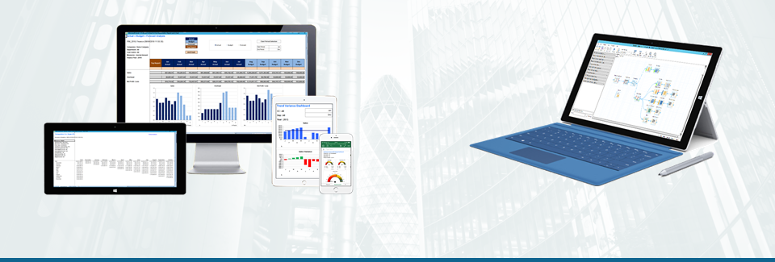



EiB Case Study: The Uniform Chart Of Accounts.
Presented by Jon Hacking on behalf of Cesco Righetti

Slide 2
Introduction
The Bulgari Hotel, London is a glamorous 85 room Hotel set in the heart of Knightsbridge with a Star Michelin Chef Restaurant, a stylish Italian Bar, a multi-awarded SPA, a Private Screening room and a signature Cigar Lounge. The accounts are made internally with SAGE 200 & EiB Analytics.
Target: making a step up in producing new set of reports both for internal management and ownership
  We took the opportunity to enhance the information provided on the previous set by adding statistics, ratios and control checks to ensure that the information is always accurate and truthful
  We relied on EiB senior consultants to mastermind and finalize our set of reporting
EiB Analytics Key Reports;
  CPOR: cost per occupied rooms reveals how efficient is your business based on the occupancy
  Variance and Var % shows with immediate effect the comparison vs Budget and previous year
We are considering to expand the reporting set to include some more reports which would measure the efficiency of the performance (i.e. payroll and benefits report, labour productivity)

Slide 3
Working with EiB
Increased speed in refreshing data (= higher efficiency)
  The new report open has been cut down from 7 to 1 minute
  The mapping and the report structure is more robust
Look and Feel
  The new monthly report looks more detailed and professional
  Adding a mapped Balance Sheet made the report more complete
User friendly
  The opportunity to upload into SAGE Accounting System from Excel and verify the impact of your transactions “live” increases the reliance of this product
  The opportunity to convert any report into .xls file and send them across already formatted and readable is a plus
Speed of response
  Support desk replies quite swiftly to our call / requests
  The staff is always competent and courteous when dealing with us

Slide 4
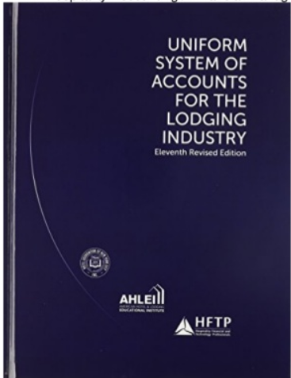
Blue Book Report
Revenue
  Rooms
  Food and Beverage
  Other Operated Departments
  Miscellaneous Income
    Total Operating Revenue
Departmental Expenses
  Rooms
  Food and Beverage
  Other Operated Departments
    Total Departmental Expenses
Total Departmental Income
The 11th Ed has introduced the Misc Income as residual category of Revenues with no Cost of Sales Associated. This account will collect all cancellation fees, gift card redemptions and F&B Pkg profit.

Slide 5
Blue Book Report
Undistributed Operating Expenses
Administrative and General
Information and Telecommunications Systems
Sales and Marketing
Property Operations and Maintenance
Utilities
  Total Undistributed Expenses
Gross Operating Profit
Management Fees
Income Before Non-Operating Income and Expenses
The 11th Ed has introduced the Information Technology with the intent to gather all System and IT expenses previously distributed across the department. This will streamline the comparison between Hotels globally. Also, an new schedule has been added (income B4 Non Op I&E) with the purpose of conveying all those expenses and Revenues not coming from Operations (bank interests, board expenses, building taxes, etc)

Slide 6
Blue Book Report
EBITDA (Earnings Before Interest, Taxes, Depreciation, and Amortization)
Interest, Depreciation, and Amortization
Interest
Depreciation
Amortization
  Total Interest, Depreciation, and Amortization
Income Before Income Taxes
  Income Taxes
Net Income
The 11th Ed has amended the definition of Profit now indicated Net Income (was Profit) as result of the EBITDA result minus all the components indicated aside.

Slide 7
Blue Book Report
Labor Costs and related Expenses
Salaries, Wages, Contracted Labor and Bonuses
  Salaries and Wages
    Management
    Non-management
      Sub-Categories as needed
  Sub-Total: Salaries and Wages
  Contracted, Leased or Outsources Labor
  Bonuses and Incentives
    Total Salaries, Wages, Service Charges, Contracted Labor and Bonuses
    Payroll-Related Expenses
    Payroll Taxes
    Supplemental Pay
  Total Payroll Related Expenses
Total Labor Cost and Related Expenses
The 11th Ed has introduced the separation between Mgmt and Non Mgmt personnel to render the comparison easier as well as considered the Contract Labor as part of the Payroll costs. In fact, by accounting Labor regardless how it is paid (directly or indirectly) within the same category, makes the efficiency ratios working more consistently.

Slide 8
Blue Book Report
New Ratios Introduced:
CPOR: cost per occupied Room
Per CVR: Revenue (or cost) per cover served
FTE: full time equivalent
Flow through: ratio which measures the efficiency compared to LY or BUD
GOP Retention: ratio which measures the ability to convert profit given a certain incremental revenue vs LY or BUD
Electric and Gas usage and ratios to measure the impact of the energy saving initiatives
The 11th Ed has introduced a number of Ratios which were not present on the previous version which can bring immediate evidence of how efficient is the business and focus the attention on those areas which require action.

Slide 9




MI Partnership
Design Optimal COA Setup in Sage
Create New Sage Database with New COA Structure
Map COA to Bluebook Structure
Build Bluebook Structure In EiB Financial Analytics
  Load Historic Data Into Sage
Create and Format Report In EiB Report Studio

Slide 10
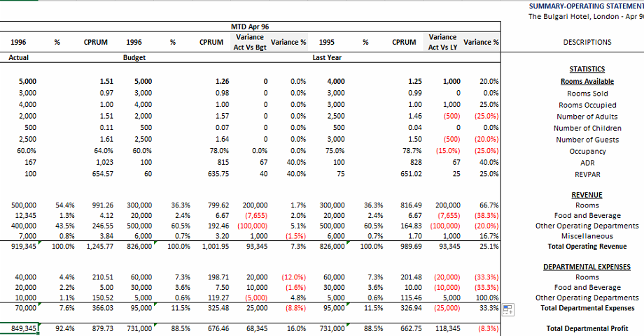
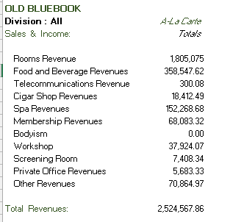
Blue Book Report – Then Vs Now
The improvement between the old version and the new one is quite significant in terms of accuracy and presentation of the results.

Slide 11
Blue Book Report - Then Vs Now
Then
Now
38 Schedules – 38 Source Reports
5-10 Minute opening time
30 Minute Data Refresh
Just Financial Data
No Balance Sheet
Manual Formulas To Sum Segmented Departments
Manual process to copy data to separate Summary Report Workbook
40 Schedules – 2 Source Reports
1-3 Minute Opening Time
3-5 Minute Data Refresh
Financial + KPI Data
Balance Sheet
Fully Automated
Separate Summary Report Included in Same workbook

Slide 12
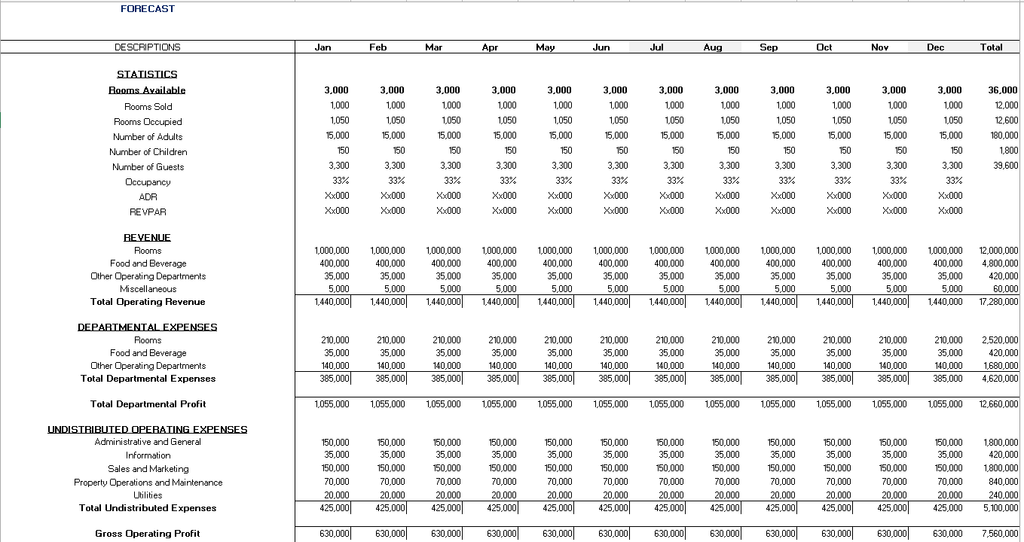
Further Reports – Forecast Reporting
Using New Bluebook Report to more easily replicate complex structure to show new information
Mixed Trend Possible without cube report using Macros
The new BB provide with FCST and trends which include Actual results plus FCST (or Budget) till the remainder of the Year.

Slide 13
Further Reports –
Payroll Dashboard
COMMENTS
FO: HC 16 vs 17 BUD
REV: HC 8 vs 9 BUD
HSK: HC 27.5 vs 32 BUD
CON: HC 19 vs 20 BUD
TOT S&W vs Revenues
MAY: 8.3% vs 7.0% BUD
YTD: 9.5% vs 9.9% BUD TOT S&W & CL vs MAY: 11.2% vs 9.2% BUD
YTD: 12.7% vs 13.4% BUD
The Dashboard allows non finance managers to immediately realize the efficiency of their department in terms of Payroll.

Slide 14
Benefits of EiB Financial Analytics
Feasibility – Most of what I have discussed would not be possible to automate without EiB Financial Analytics
Time Saved – Hours of time saved running reports on a daily/monthly basis
Scalability – If a new department is added, Can be easily added to the Sage Accounting system and BB Report with the existing rules and structures.
If a new report is needed using the existing structure, it can be created easily and efficiently.
Safety/Support – All Reports are backed up daily, EiB has a ‘project educated’ and highly responsive team for any support issues.

Slide 15
EiB Case Study: The Uniform Chart Of Accounts.
Presented by Jon Hacking on behalf of Cesco Righetti

