Slide 1
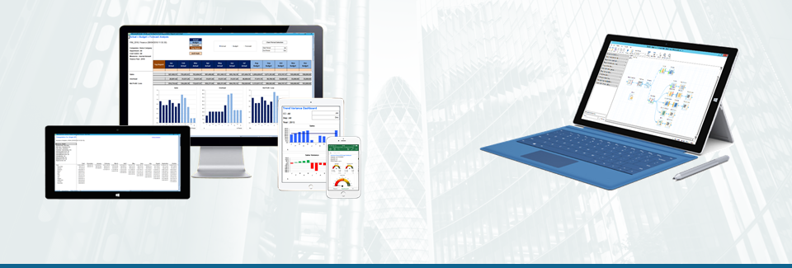
EiB Case Study: Two Years On From Starting MGA MI –
The Trials, Tribulations & Rewards.
‘Management Information is for Life not just for Christmas’
Presented by Garry Watson

Slide 2
Agenda
Who or what is a WMIL?
How did we get into this mess in the first place?
25th May 2014
New beginning – O’s staying down, WMIL going up
Management Information is for life, not just for Christmas

Slide 3
Who or what is a WMIL?
WMIL is a Managing General Agent
We offer underwriting products to the broker to supply to his customers (policyholders) and sit between the broker and the ultimate insurer
Established 2011/2012
What do WMIL underwrite?
We underwrite commercial fleet business (Taxi, Courier and General Fleet)
We underwrite circa £20m of GWP
How are we judged?
Shareholders and investors by profit
By our Capacity/Carrier (New India) by delivering an underwriting profit (Premiums are more than claims, reinsurance, acquisition and other costs)

Slide 4
How did we get in such a bloody mess?
It’s not just us! The insurance industry and software houses were not ready for the new generation of MGAs
General lack of investment over the past 30 years
Emerging MGA Market not understood by the software industry or their capacity
Modern .net style technology, but lack of understanding of the business model and the information required to run the business
How were we getting through the day?
Basically, we weren’t
Manual process using Excel and old cigarette packets
Highly paid and experienced staff downloading and manipulating data
Poor decisions based on bad data
Let’s not even talk about triangulations ………………

Slide 5
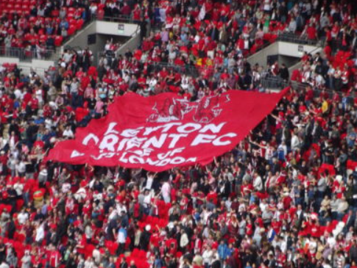
25th May 2014
An hour or two before kick-off …. Orient v Rotherham play-off final 2014 the day it all changed for WMIL and the O’s

Slide 6
25th May 2014
A chance meeting with Paul Martin
(who, just to clarify things is a Spurs supporter)
Firstly I need to point out that drink had been taken ………………
Me “Hi Paul, not seen you since the class of 79”
Paul “You’ve got fat and bald”
Me “Have you looked in the mirror lately”?
Paul “What you doing these days”?
Me “Insurance, run an MGA, don’t expect you to know what that is, you”?
Paul “I run a company that supplies management information solutions”
Me “Really, we should talk ……. Let me just go and watch Orient get promoted and I will give you a ring”

Slide 7
25th May 2014
Half-time ……………. 2-0 to the Orient! And at this moment I am not even worried about our Management Information. Championship here we come

Slide 8
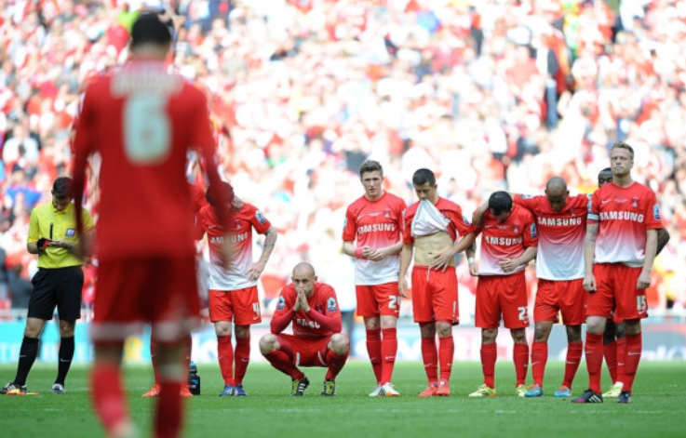
25th May 2014
Full-time ………………… Lost on penalties. A defining day for the O’s and also for WMIL

Slide 9
25th May 2014
WMIL was at this stage at a very low point
Poor underwriting results
Losing money
Unable to produce even simple reports without laborious and manual processes
Losing the faith of both capacity and investors
Unable to convince our software house to develop what was needed and unable to afford to go elsewhere
Time to engage with EiB

Slide 10
New Beginnings…
WMIL and EiB meet and another one of those conversations
Us
“So we have an MI problem, but the data is great, we just need a way to cut and dice it””
EiB
“Sorry, we reckon the data is probably crap and the first step is to cleanse it”
Us
“Look, we have only been using this modern trading system for a couple of years, there are drop tabs on the front-end, everything is validated. The system and data are fine it is just our MI that is killing is”
EiB
“Okay, give us some data validation basic rules and we will go from there”
Us
“Nothing will be wrong …………. Claims need to full inside the policy periods, MTAs need to occur whilst the policy is live, etc. etc.
Us
“Oh, and by the way, we need to talk to you about triangulations"

Slide 11
New Beginnings…
Yes, EiB were right, our data had problems
EDI messaging and claims feeds had corrupted our data
Loads of problems with dates not meeting the rules supplied
EiB provided a portal to move ‘invalid’ transactions to and allow us to cleanse the data
Painful process, but we found out that we were basing decisions on poor information
Reports developed
Immense patience from EiB in working with underwriting team and developing a suite of reports
Ability to run reports by any and all combination of underwriting criteria (i.e. location, age bands, products, etc.)
Standard, Monthly MI Pack produced that covers all aspects of the underwriting book and allows full account analysis
Oh yes, triangulations. WMIL now have the ability to run all triangulations on an earned or written 365th basis allowing for accurate understanding of trending of our claims and performance of the account

Slide 12
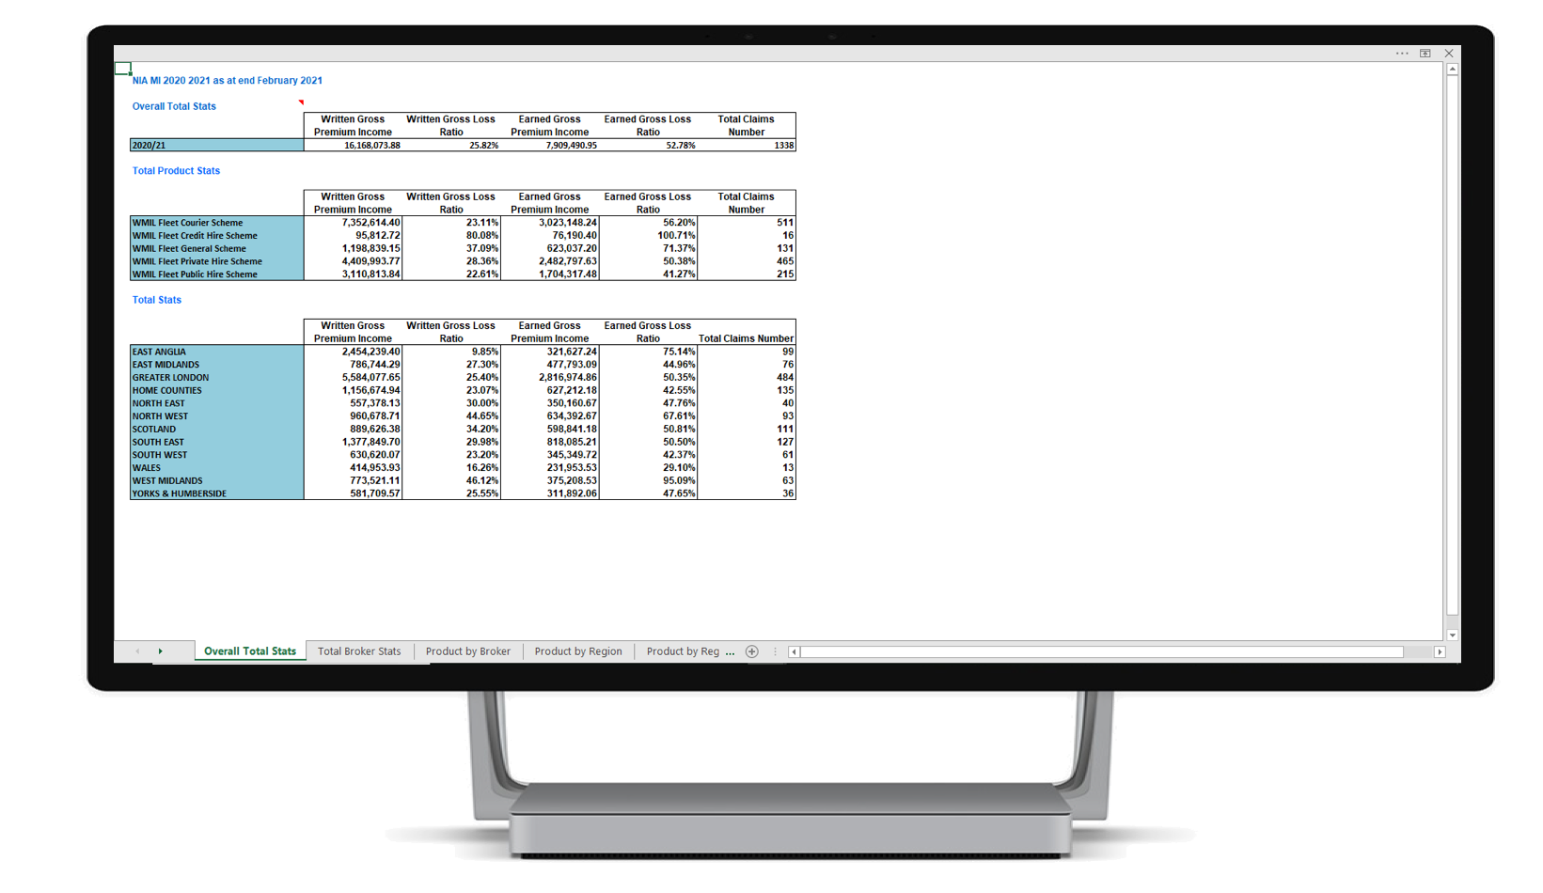
Diversity Of Carrier Information

Slide 13
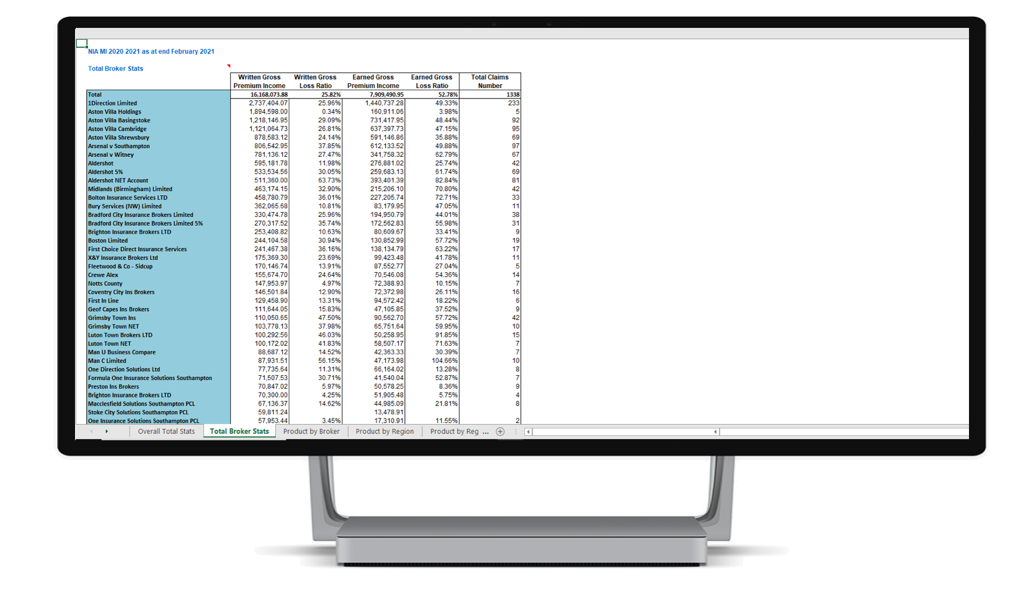
Diversity Of Carrier Information

Slide 14
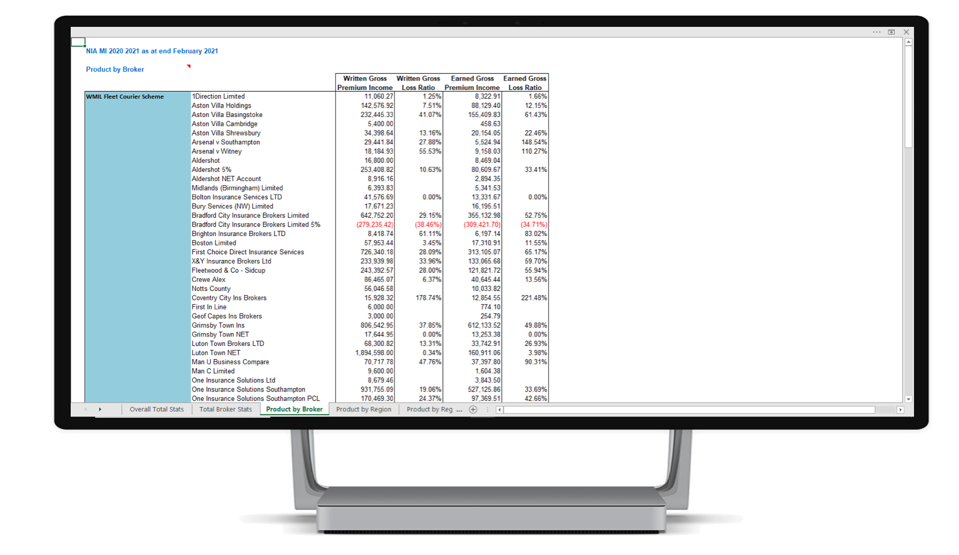
Diversity Of Carrier Information

Slide 15
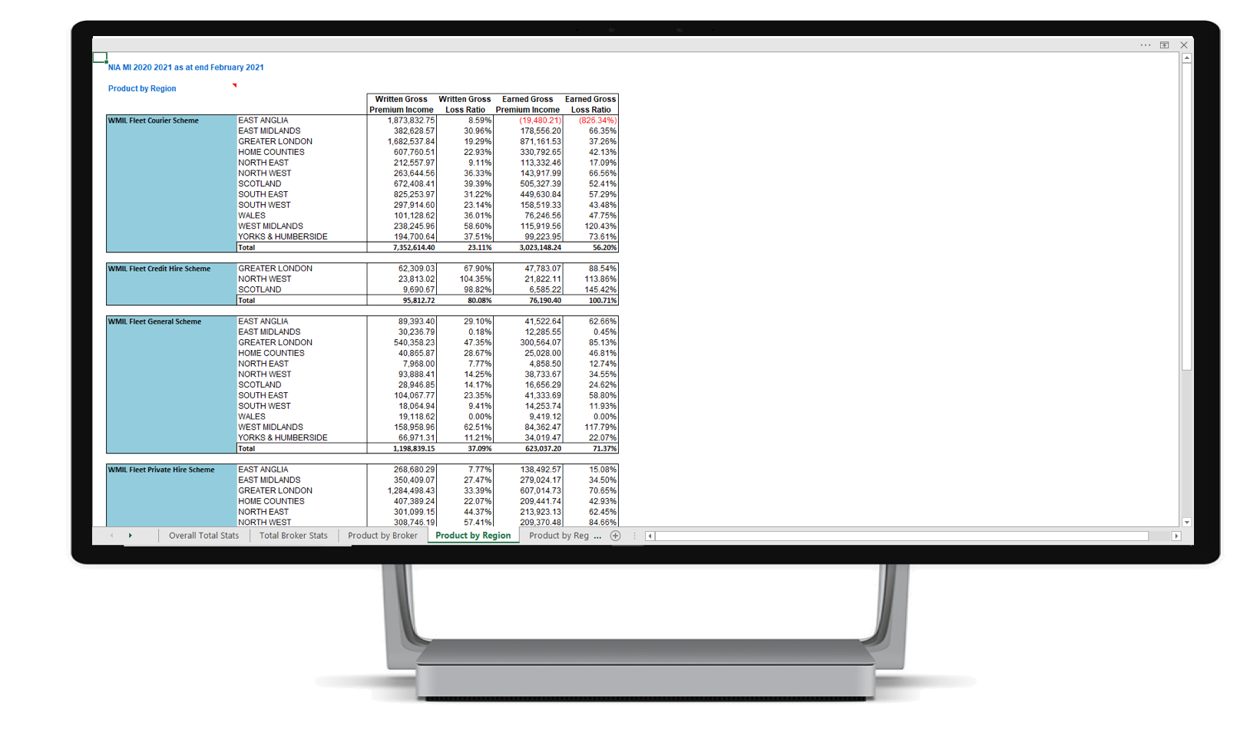
Diversity Of Carrier Information

Slide 16
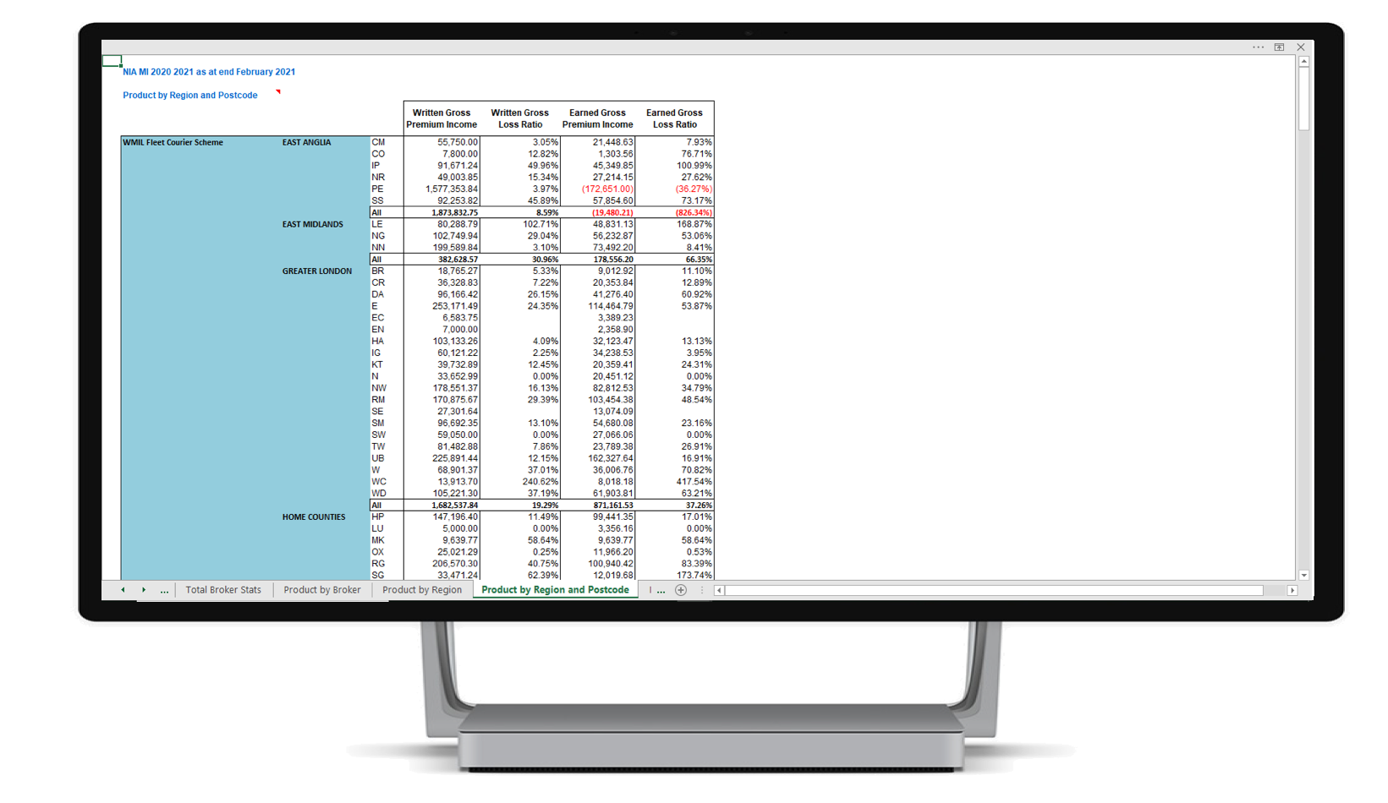
Diversity Of Carrier Information

Slide 17
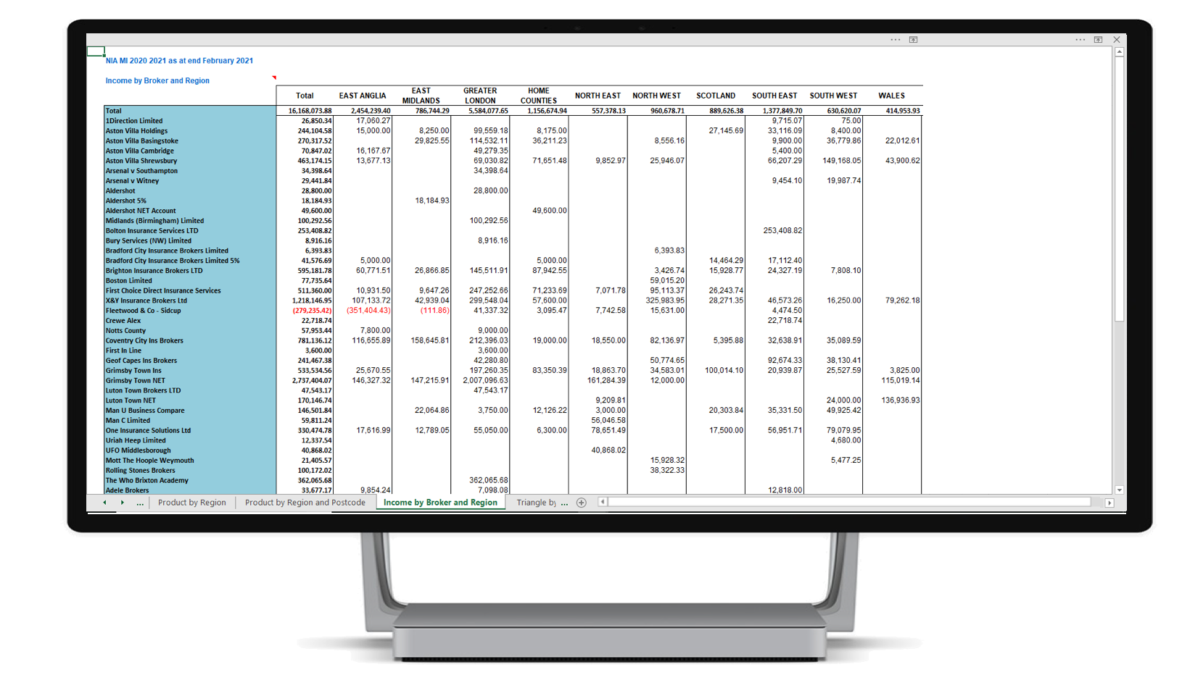
Diversity Of Carrier Information

Slide 18
New beginnings
Lesson learned
This will not happen overnight.
Quality of the data is everything
Don’t just focus on the end goal but on the steps needed to get there. We wanted reports quickly, without the cleansing process we would have been no better off. Just faster, inaccurate reporting
Quality of the data is everything
Make it a partnership. EiB will work with you, but you need your business decision and practitioners to find the time to support them
Have a plan, work to the plan, do not get side-tracked by undeliverable deadlines or pressure from third parties
Quality of the data is everything
Understand that without accurate information bad decisions are made and these decisions will likely impact your bottom line
Quality of the data is everything

Slide 19
Management information is for life, not just for Christmas
Where are we now and where are we going?
WMIL have now produced an operational profit for each of the last two years and well on their way to another one in 17/18
Our underwriting results are better than in any of our previous trading years and the targeting of regions and areas based on account analysis had had dramatic impacts
Our needs and view of our products is constantly changing and with it our view of what we need our Management Information to help us with must change
Make sure that the impact and needs of the back-end of your system is clearly in your mind when making process or system changes within your business
Understand that the data you hold is your most valuable asset. It is your experience, your knowledge, your basis for making key decisions. If it can’t be trusted, neither can your business plans
Data is your Intellectual Property and your route to achieving a successful business. Take care of it and look after it
Don’t stop evolving, but remember it is not always what is coming through the front-door that delivers profit to your business model
Quality of the data is everything

Slide 20
Management information is for life, not just for Christmas
Meanwhile, what happened to the Orient on the 25th May
Orient were sold next day to a multi-million pound Italian Chairman
He had money, but no vision
He focused on the end goal without understanding the steps to get there
He wanted quick results and demanded immediate promotion
He sacked 10 managers in three years
Orient were relegated from the First Division to the Second Division and then from the Second out of the Football League
He sold the club to multi-million pound Orient Fan and Businessman in July 2017
The man has a vision and a plan and believes in getting the fundamentals right
The club has found its self-belief again
Hopefully this will be seen as their EiB moment

Slide 21
EiB Case Study: Two Years On From Starting MGA MI –
The Trials, Tribulations & Rewards.
Presented by Garry Watson

